Slide 1

Data Platform & Analytics
(Rethink all the Analytics)
by
Atsu Vovor, MMAI, BSc
Master of Management in Artificial Intelligence

Slide 2
Data Analytics Leadership Model
Strategic Vision: Developing a clear vision for how data analytics can support the organization's goals. This includes identifying key areas where data can provide insights and drive decision-making.
Data Governance: Ensuring data quality, security, and compliance with relevant regulations. Implementing policies and procedures for data management and usage is crucial for maintaining trust and integrity.
Technical Proficiency: Understanding data analytics tools, methodologies, and best practices. While a leader may not perform technical tasks daily, having a strong grasp of the field is essential for guiding the team and making informed decisions.
Innovation and Adaptability: Staying abreast of industry trends and emerging technologies. Encouraging a culture of innovation where the team is open to experimenting with new tools and techniques.
Stakeholder Communication: Effectively communicating insights and recommendations to non-technical stakeholders. This includes translating complex data findings into actionable business strategies.
Performance Measurement: Establishing key performance indicators (KPIs) to measure the impact of data analytics initiatives. Continuously monitoring and refining strategies based on performance data.
Ethical Considerations: Promoting ethical use of data and ensuring that analytics practices respect privacy and other ethical standards.

Slide 3
Data Analytics Team Framework
We use empathy to understand the
business
Operations,
customer
Experience and identify key areas for data inside
3
We Integrate the
Data model and mathematical/
statistical models
into the business
decisions or
processes
1
5
Data Preparation, Analysis and Modeling: We do data integration and cleaning.
We Perform the data analysis and model development using the appropriate techniques
We make sure of the data availability, usability, integrity, security and compliance
We continuously monitoring and enhancing the models and strategies
We interpret the
results within the
business context
We favor stakeholders meeting to validate the Dashboards, Reports, and Data Stories.
We use a data collection form template to understand and document project stakeholders' level of implication and all the existing data tables and reports structure
6
2
4
1 & 2 Client Brainstorm Meeting
3 - Prototyping
4 - Model Evaluation and Validation
5 - Deployment
6 – Data governance

Slide 4




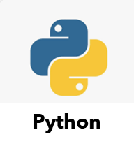
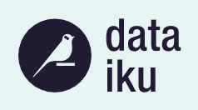




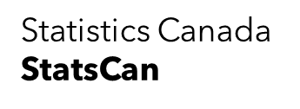


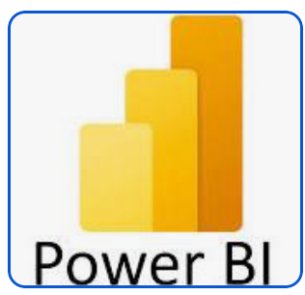
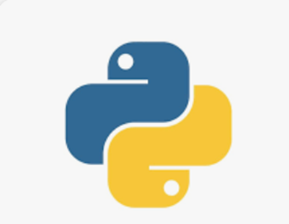
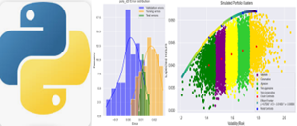
Ython
Data Analytics System
Data Sources API
Data Engineering
Data Repositories
Data Preprocessing and Models development Engine (with Python)
2
Amazone S3
1
SharePoint
SQL Server/SQL Server Data Lake
3
Data Visualization
1 & 2 ETL/ELT(Extract, Transform & Load)
3 Data Utilization
Python

Slide 5
References
https://www.ibm.com/docs/it/SS3RA7_18.3.0/pdf/ModelerCRISPDM.pdf

